Slide 1
3rd IOPEPC Global Oilseeds Conference (IGOC)
Ethiopian Sesame Market Trend and outlook
Presented by Mr. Assefa Yohannes
General Manager of Ethiopian Pulses Oilseeds and Spices Processors Exporters Association.
October , 2021.

Slide 2
OUTLINE
Ethiopia the land of crop diversity
Ethiopian Sesame production trend
Ethiopia Sesame Export Trend
Ethiopian Sesame Inventory
2021 The situation of sesame cultivation
Current Situation of sesame growing areas
Expectation and recommendation

Slide 3
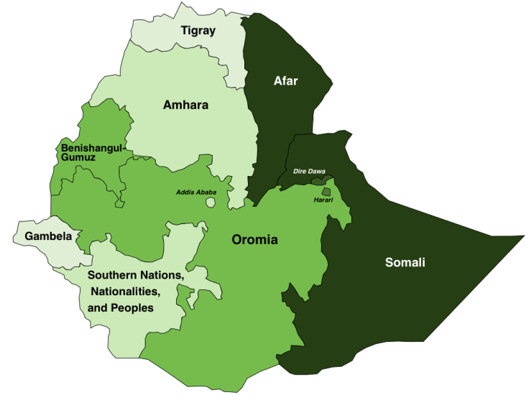
1. Ethiopia the land of crop diversity
Sesame Growing in many different regions of the country
31%
Humara
Gondar
59%
2%
Wollega
8%
0.3%
0.3%
Sesame producing areas.

Slide 4
2. ETHIOPIAN SESAME PRODCUTION TREND
2.1 Ethiopian Sesame Production

Slide 5
3. Ethiopia Sesame seed Export Trend.

Slide 6
Major Ethiopian sesame seed export destinations.
2020/21 Top Ethiopian Sesame destination

Slide 7
4. Ethiopian Sesame Inventory
ECX Traded from November/2020- to September/2021 ₌ 155,000 tons
Last year carry over = 30,000 tons :
Export performance of new crop ( Nove,2020- September,2021) = 181,866 tons
Inventory on the hand of Exporters till Sept 30, is estimated = 3,134 tons
Inventory on the hand of Suppliers till Sept 30, is estimated = 5,000 tons
Total inventory = 8,134 tons

Slide 8
5. 2021 The situation of sesame cultivation
Due to the instability in few sesame growing areas of the country there is a slight decline in sesame area coverage. Total estimated area coverage is 550,000 hectares. Last year it was 600,000 hectares. Compared to last year there is a slight decline of 50,000 hectares.
Fortunately in most of emerging sesame growing areas of the country like Oromia, Somalia and southern region sesame area coverage is improving.
The whether condition in almost all sesame growing area is very conducive. As a result improved productivity is expected.

Slide 9
6. Current Situation of sesame growing areas
No weather catastrophe affecting the sesame growing areas is observed this year.
No sign of pests infestation or hazardous condition is observed in most of sesame growing areas.
Rain fall is suitable in most of sesame growing areas.
Therefore the decline in area coverage is expected to be trade off by improved productivity.

Slide 10
7. Expectation and recommendation
Globally in most countries, oil crushing factories are opened, restaurants are opened school feeding is started and health awareness of sesame is globally increased therefore, demand is expected to be high and supply is expected to be low so upward price is expected.
The markups of trading houses supply chain managing companies sesame value added product producers and retailers is very high as compared to the price paid to sesame farmers. This is discouraging farmers to produce sesame and many are switching to other products. Gradually the supply of sesame seed to the global market will decline significantly unless all stack holders of the industry work together to improve both price payment of the farmers and sesame productivity at farmers level.

Slide 11
“ We cordially invite you all to participate in our webinar oilseeds and pulses International conference to be held in November 23, 2021”
Board of Directors of EPOSPEA
To register:- www.epospeaeth.org

Slide 12
Thank you! Mr. Assefa Yohannes General Manager , Ethiopian Pulses, oilseeds and Spices Processors Exporters Association
Email :epospea@gmail.com
Mobile : +251-914 70 33 34
Website:- www.epospeaeth.org

