Slide 1
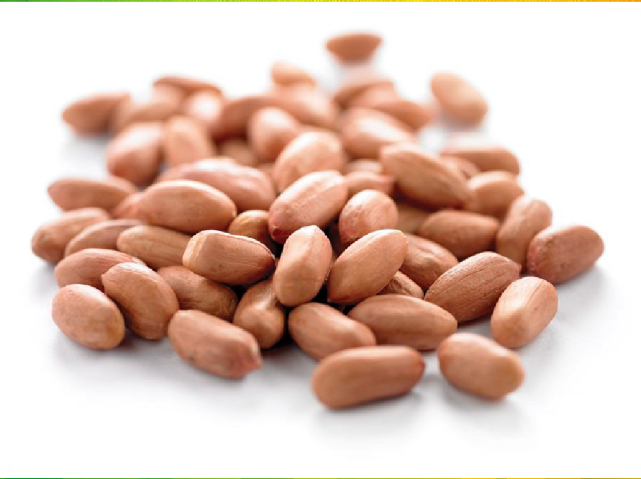
Overview of Senegal Peanut Trade
Oct ’ 2021

Slide 2
Contents
Senegal PN Introduction
China Demand
Senegal-China Trade Outlook

Slide 3
Senegal Peanuts：Area & Production
Total planting area of crop 2021 is about 1.3 million Ha with output 1.86million tons of peanuts (inshell term).
Notes:
This is about 5-6% increase of crop 2020

Slide 4
Senegal Peanuts：Balance Sheet
Item Name | Est Usage | % Share
Deshelling Loss | 575,198 | 32%
Domestic Consumption | 539,248 | 30%
Retained Seed | 144,000 | 8%
Exports | 500,000 | 30%
Total | 1,797,495 | 100%
Export accounts for 30% of the total production basis inshell terms.

Slide 5
Senegal Peanuts：Exports
More than 95% of the export comes to China.
Since 2015, export volume to China has been increasing gradually.
In 2018, volume dropped because of the bearish market in China.

Slide 6
China Imports : kernels/Inshells
Source of data: China/Vietnam Customs
Till Aug’ 2021, China has imported around 325,000 MT of Senegal PN which is the historical number.
Senegal peanuts accounts for 37% of China total peanuts import in 2021.
In the last season, Senegal government has forbidden Dakar port trade and only allowed factory purchase in origins.
Unlike the operation in previous years, Senegal government allowed peanuts export since Feb only.
Senegal Government also started a very strict rule for foreign currency repatriation.

Slide 7
China Imports : Peanut Oil
Source of data: China Customs
Till Aug 2021,China PN oil import volume has gone up to 240k mt, it will reach 300k by Dec 2021.
The rise in Exports to China by Senegal has resulted in reduced crushing in the origin.

Slide 8
China Demand : Export
Source of data: China Customs
Till Aug 2021,China PN export volume is only 230k mt, whole year estimated volume will be only 330k mt, which is about 100k mt lower than year 2020.
Main reason of the decrease is because of the extremely high sea freight.

Slide 9
China Demand : Crushing
Source of data: Industry Estimate
One of the big peanut oil player in China has purchased more than 1 million mt kernels in the past season, last time when their volume crossed 1 million mt was year 2017 while China peanut market prices crashed.
Thus their stock level is very high either in kernel term or in oil term.
Overall small package sales in China is not as good as last year.
There is no news about when will they start purchase for new season now.

Slide 10
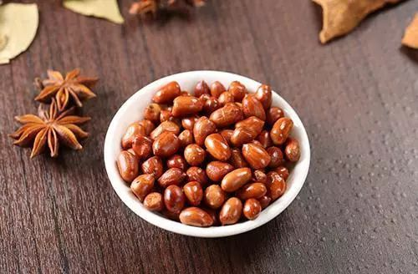
China Demand : Edible Segment
We have heard from many local traders that their traded volume to food segment has reduced by 20-30% this year.
Extremely high soy oil price has also depressed the fried peanuts demand as the processing cost increased too much.
One of the reasons of low demand is because of the covid situation, less travelling/less outing/less restaurants etc.

Slide 11
Senegal-China Trade Outlook
Currently new crop progress looks good.
In new season, Senegal government may continue to close Dakar port trade due to the covid situation and only allow trade in origins .
They may also continue the foreign currency repatriation rules for the new season.
China peanut market is very bearish which may depress Chinese buyers and they may not accept higher prices like last season-$1250-$1300.
But global plant oil prices are at very high level, Senegal local peanut oil demand may drive the local peanut prices.
Logistics challenges.

Slide 12
Disclaimer
This presentation includes forward-looking statements and views. Because such statements and views deal with future events, they are subject to various risks and uncertainties and the way markets turn out could differ materially from our anticipations.
These statements made and forward looking views expressed in this presentation are merely for analysis of the market. These are not trading recommendations.
The Presenter and/or ETG cannot be held liable for any losses occurring to anyone by trading on these statements or views.

Slide 13
Thank You

