Slide 1
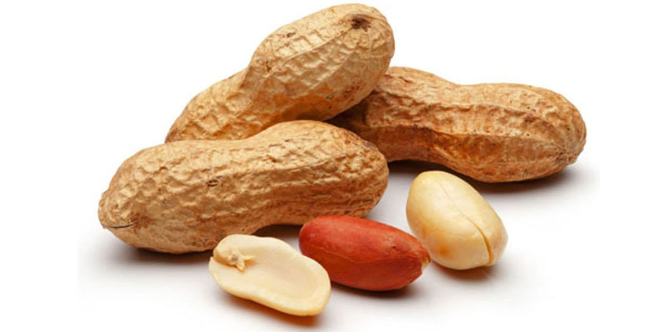
IOPEPC Global Oilseeds Conference (21 October 2021)
Kanak Thakker
Co-Convener, IOPEPC Groundnut Panel

Slide 2
More than Six Decades of Service to Oilseeds & Oils Industry
Designated as nodal body by Ministry of Commerce, Govt. of India for Promotion and Development exports of oilseeds and oils
Issues Certificate of Export for Sesame Seed to EU as per DGFT requirement
Issues Official (Health) Certificate for Sesame Seed as per EC legislation
Some of the activities are:
Oilseeds Crop Survey, Export Awards, Regional Annual Meets
Arbitration for domestic and global contracts
Disseminate latest developments in consuming & supplying countries
Capacity building programs enhancing quality , food safety systems, hygiene standards, quality requirement of importing countries
Create awareness amongst the farmers to use safe and permissible pesticides, GAP, GMP, documentary films on GAP and GMP.
Resolving issues faced by exporters

Slide 3
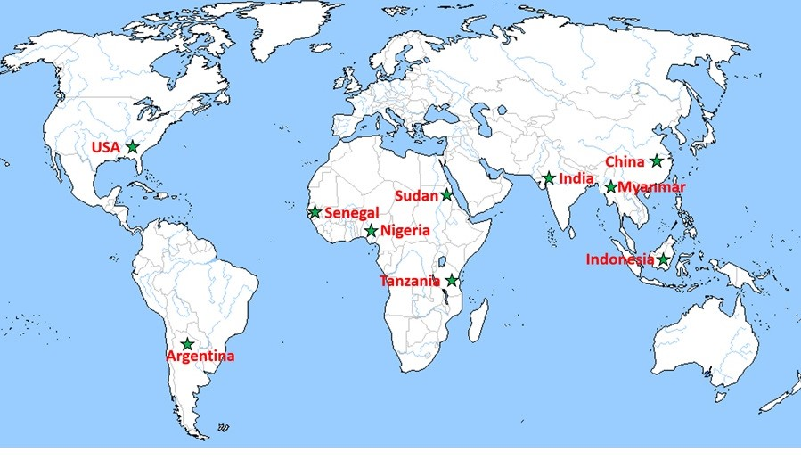
Top 10 Producing Centers in the world
China, India, Nigeria, USA, Senegal, Sudan, Argentina, Myanmar, Tanzania and Indonesia (in decreasing order of annual production)

Slide 4
Groundnut: The top five global players
Country | Area | Production* | Yield
 | ('000 ha) | ('000T) | (T/ha)
China | 4600 | 11500 | 2.50
India | 6100 | 4800 | 0.79
Nigeria | 2890 | 2750 | 0.95
USA | 654 | 2087 | 3.19
Senegal | 1300 | 1100 | 0.85
 | 54% | 67%
World | 28923 | 33022 | 1.14
*As kernels
Source: Oil World 2021
Acreage India ranks first | Production India ranks second | Yield India ranks fifth

Slide 5
India in Global Perspective
Acreage (million ha): World: ≈ 28.92 India: ≈ 6.10 (21.09%)
Production (kernels) (million MT): World: ≈ 33.02 India: ≈ 4.80 (14.53%)
Export (000 T): World: ≈ 3,408 India: ≈ 638 (18.72%)
Source: Oil World, 2021

Slide 6
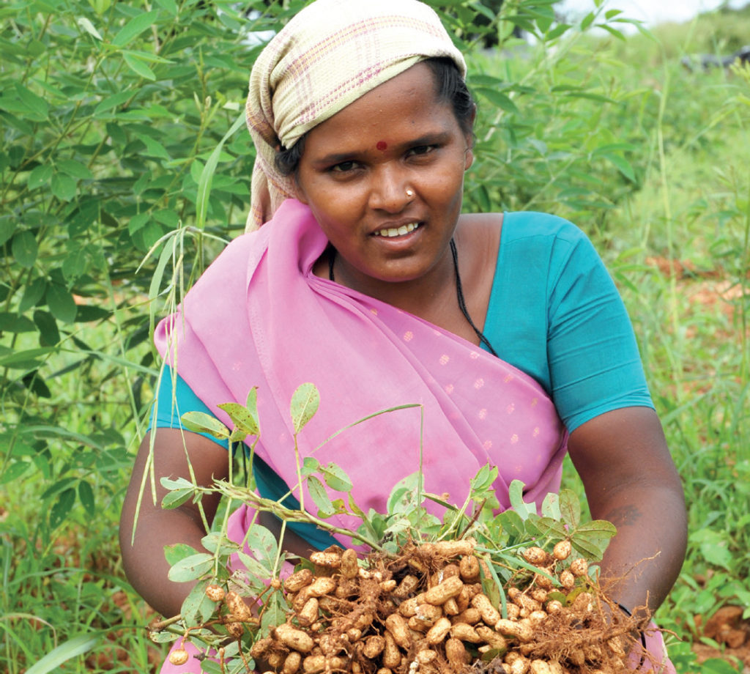
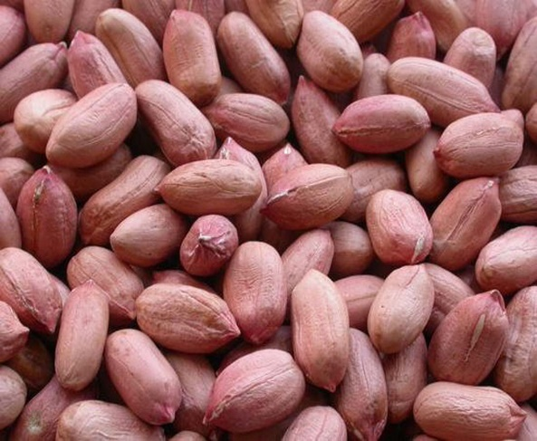
Groundnut in India
Not a truly indigenous crop
Introduced in the first half of the sixteenth century
By 1850, about 1,000 ha and by 1895, about 70,000 hectares in South Arcot district of Madras Presidency
Now cultivated on about 6.5 Mn ha in nearly all the states of India

Slide 7
Importance of Groundnut Crop
An oilseed and a supplementary food crop.
The seeds are consumed directly as snacks (boiled, roasted, fried) and in form peanut butter
Groundnut oil is a very good cooking medium and has many industrial applications as well
Oil cake and de-oiled cake are used as animal feed stoc
The crop improves soil fertility by fixing atmospheric-nitrogen
Foliage provides a nutritious fodder for cattle
Shells converted into particle boards and briquettes

Slide 8
Groundnut: Nutritive value & health benefits
An economic source of healthy oil; no trans fat; high Mono Unsaturated Fatty Acids (MUFA) and Poly Unsaturated Fatty Acids (PUFA)
Rich in quality protein, vitamins (B group and E) and minerals (magnesium, phosphorous, potassium, zinc, iron, copper, manganese and selenium)
Omega-3, however, is not present
Lowers risks of heart diseases, diabetes, and colorectal cancer. Helps to lower blood pressure.
Resveratrol, an anti-aging molecule, fights proliferation of fat cells and improves sugar uptake from the blood.
Groundnut phytosterols reduce the blood cholesterol.

Slide 9
India’s Production and Exports of Oilseeds (2020-21)
Oilseed | Production (tons) | Export (tons) | % of export against production
Groundnut (kernel) | 7083300 | 638580 | 9.02
Sesame | 792000 | 273130 | 34.49
Soya | 13400000 | 68590 | 0.51
Rapeseed/mustard | 9987000 | 56560 | 0.57
Niger | 39000 | 19590 | 50.23
Linseed | 111000 | 11940 | 10.76
Safflower | 48000 | 3980 | 8.29
Sunflower | 281000 | 1330 | 0.47
 | 31741300 | 1073700 | 3.38
Source: MOC/ Trade

Slide 10
India’s Exports of Oilseeds (000 Tons)
Sr.No | Oil seed | 2020-21 | 2019-20 | % Share
 |  | Qty. | Qty.
1 | Groundnut | 638.58 | 664.44 | 59.43
2 | Sesame seed | 273.13 | 282.26 | 25.42
3 | Soyabean | 68.59 | 74.67 | 6.38
4 | Mustard / Rapeseed | 56.56 | 31.78 | 5.26
5 | Niger seed | 19.59 | 13.83 | 1.82
6 | Linseed | 11.94 | 12 | 1.11
7 | Safflower seed | 3.98 | 2.61 | 0.37
8 | Sunflower seed | 1.33 | 1.2 | 0.12
9 | Cottonseed | 0.74 | 0.38 | 0.07
 | Total | 1074.44 | 1083.17 | 100
Source: DGCIS/MOC (April-March)
Share of Groundnut kernel and Sesame seed exports in the total oilseed exports was about 59% and 25% respectively during 2020-21.

Slide 11
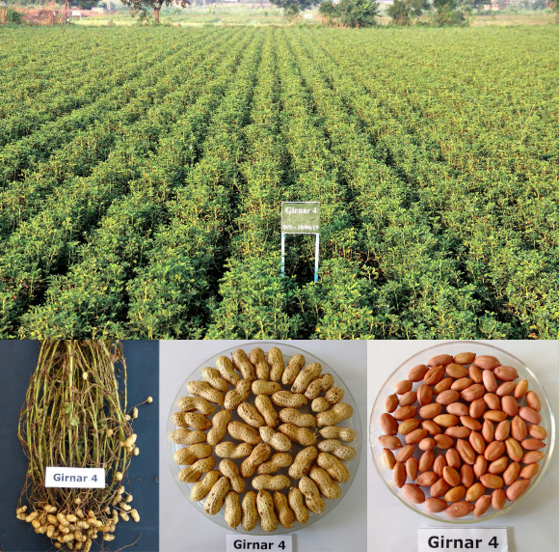
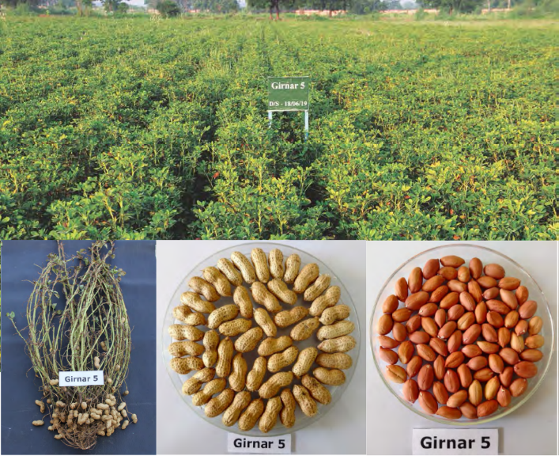
India’s First Ever High-Oleic Varieties
Girnar-4 Virginia Group Oleic acid: 79.2 to 80.6% CPO: 65.9 |  | Girnar-5 Virginia Group Oleic acid: 78.9 to 80.7%. CPO: 69.1

Slide 12
Pod yield of Girnar-4 and Girnar-5 groundnut varieties in five locations
(average values of 2017 and 2018)

Slide 13
Overview of India Groundnut Scenario
India is the second largest groundnut producer in the world after China with production of about 5 million tons of kernels.
Two main varieties grown are Java (Spanish) and Bold (Runner) along with Red Natals.
Government of India has initiated action to upgrade all the export oriented groundnut processing units to world class level.
India also processes and exports raw and refined groundnut oil.

Slide 14
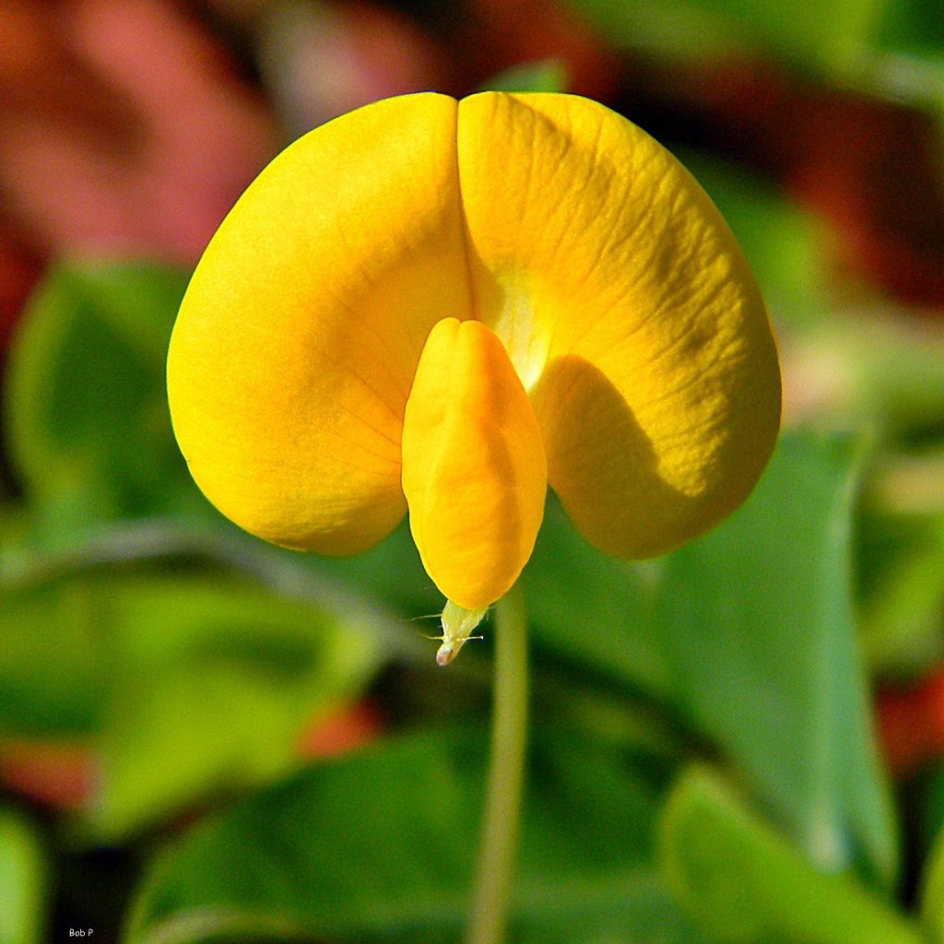
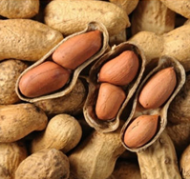
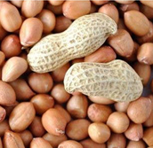
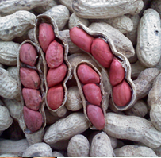
Indian Gorundnut: Seed Colour & Size Diversity
More than 210 varieties notified
About 40 varieties in seed chain
Java, Bold & Red Natal are grown
Two high-oleic type developed
No GM
Virginia
(Bold)
Spanish
(Java)
Valencia
(Red Natal)

Slide 15
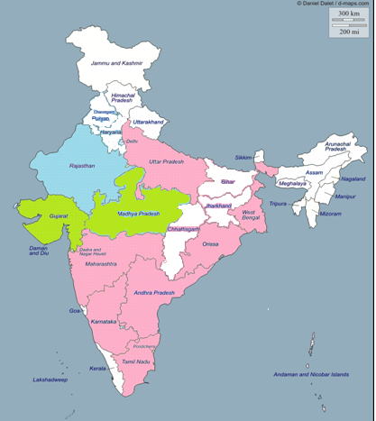
States
producing
Bold (Runner)
and
Java (Spanish)
variety of
Groundnut
Java
Bold
Both
Total Indian Winter and Summer Production
Java (60-65%): Bold (35-40%)
Java also being grown in some packets of Rajasthan and Uttar Pradesh

Slide 16
The harvest time in major states
State | Kharif | Rabi | Summer
Gujarat | Oct-Nov |  | May-June
Rajasthan | Oct-Nov
Maharashtra | Oct-Nov |  | Apr-May
Andhra Pradesh | Oct-Nov | Feb-May
Karnataka | Sep-Oct | Feb-May
Tamil Nadu |  |  | Apr-May

Slide 17
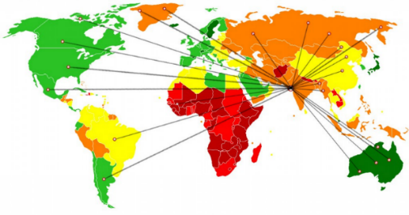
India's Export of Groundnuts (Tons)
Nearly 13% of the annual kernel production is processed for export
S.No. | Country | 2020-21 | 2019-20 | % Share
 |  | Qty | Qty
1 | INDONESIA | 211,860.18 | 213,821.57 | 33.18
2 | VIETNAM | 129,922.00 | 140,453.68 | 20.35
3 | CHINA | 73,190.67 | 34,082.00 | 11.46
4 | PHILIPPINES | 45,751.51 | 47,672.62 | 7.16
5 | MALAYSIA | 35,351.19 | 35,145.76 | 5.54
6 | THAILAND | 33,762.60 | 30,022.84 | 5.29
7 | UAE | 14,088.31 | 13,112.60 | 2.21
8 | NEPAL | 12,347.68 | 13,755.10 | 1.93
9 | RUSSIA | 12,267.40 | 20,203.48 | 1.92
10 | UKRAINE | 10,812.00 | 15,107.00 | 1.69
 | Others | 59229.38 | 101066.27 | 9.28
 | Total | 638,582.92 | 664,442.92 | 100
Source MOC

Slide 18
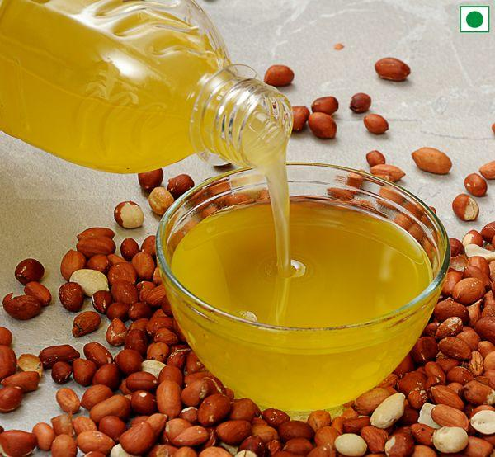
India's Export of Groundnut oil
Share in Global Prod’n ≈ 15.46%
Share in Global Exports ≈ 50.22%
Extent of Prod’n Exported ≈ 36.73%
Source: Oil World 2021
Year | 2020-2021 | 2019-20 | 2018-19 | 2017-18
India Export Quantity (Tons) | 2,43,337 | 42698 | 17057 | 12171
Source MOC
India has exported 2,43,337 tons of groundnut oil during 2020-21 out of which export to China was 2,34,087 tons.

Slide 19
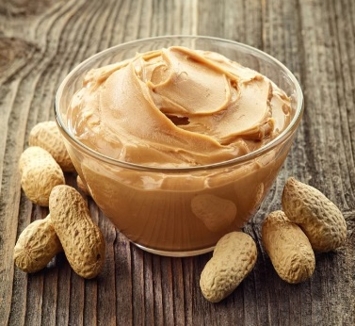
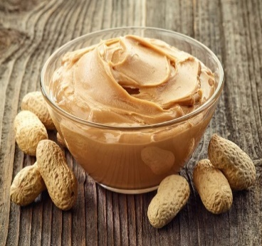
India's Export of Peanut Butter
(QTY in Tons)
Year | 2020-21 | 2019-20 | 2018-19 | 2017-18 | 2016-17 | 2015-16
Quantity | 25000 | 14600 | 12200 | 11664 | 8775 | 7634
Source: Trade
Peanut Butter production capacity in India is about 40,000 tons per annum.
India also exports about 25,000 tons of Blanched Groundnuts annually.
China did not import Indian Blanched Peanuts and Peanut Butter during 2020-21.
Blanched Peanuts and Peanut Butter is exported to Netherlands, Russia, South Africa, Iraq, UAE, Afghanistan, USA.

Slide 20
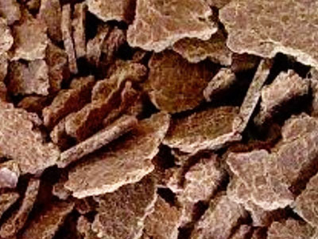
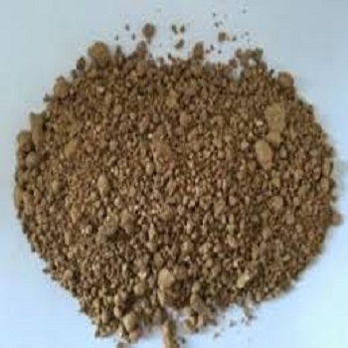
India's Export Oilcakes/Meals (Tons)
Oilcake/ Meal | Total Exports | Export to China
Soya | 20,53,062 | 29,782
Groundnut | 39,084 | 0
Other (Cotton, Rapeseed, Mustard, Sunflower, Safflower, Sesame etc.) | 22,50,944 | 10,767
Source: MoC
2020-21

Slide 21
: Disclaimer :
The contents in this presentation are based on the feedback received by IOPEPC from the trade and the Government sources. It only represents observations and does not constitute basis for any business decision.

Slide 22
Thank You
INDIAN OILSEEDS AND PRODUCE EXPORT PROMOTION COUNCIL
(Under Ministry of Commerce, Government of INDIA)
78/79, Bajaj Bhavan, Nariman Point, Mumbai - 400021. Maharashtra, INDIA
Tel: (91 - 22) 2202 3225 / 9295 Fax : (91 - 22) 2202 9236
E-mail: info@iopepc.org

