Slide 1
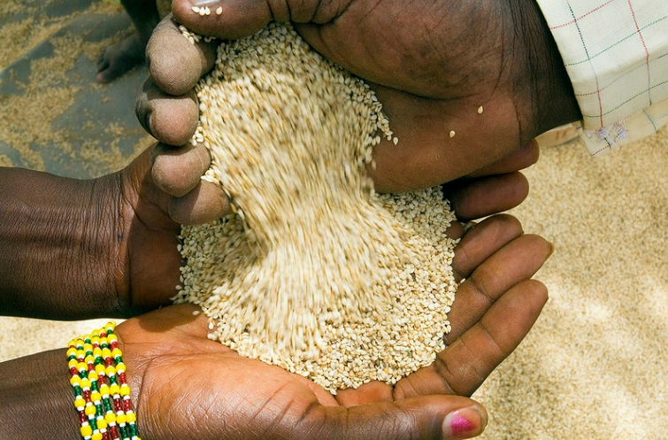
Outlook of Sesame Seed Crop in East and West Africa
By: ALOK BHARGAVA
PRARAMB AGRI TRADING DMCC DUBAI.
alok@praramb.com

Slide 2
Outlook of Sesame Seed Crop in Africa Scenario 2021/22
At the onset, I would like to congratulate IOPEPC and Office bearers for organizing the conference in hybrid mode
I sincerely wish all the members of IOPEPC all the best for the new season

Slide 3
Scope
Glance of 2021
Countries producing Sesame Seed
Overall view of African supply position
Current Trends & Carry over Situation
Future Scenario
Disclaimer
Vote of Thanks

Slide 4
African Producing Countries
EAST AFRICA
TANZANIA
MOZAMBIQUE
UGANDA
SOMALIA
MALAWI
WEST AFRICA
NIGERIA
NIGER
MALI
BURKINA FASO
TOGO
SENEGAL/GUINEA BISSUA

Slide 5
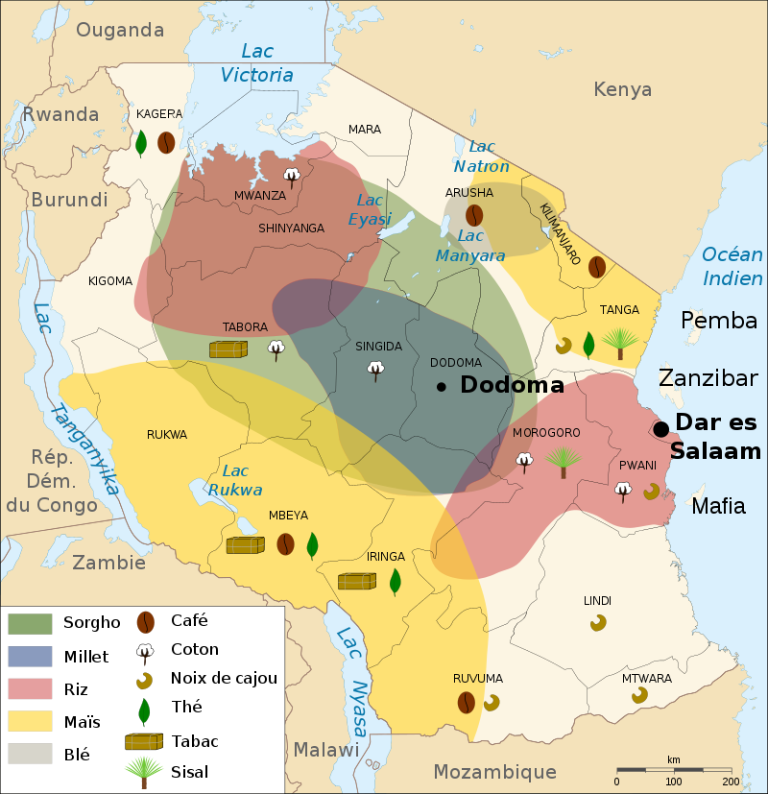
Tanzania
Producing areas: Dodoma, Songea, Babati, Mtwara, Lindi, Mbeya, etc.
Both white and mixed type available.
Production – 120/130,000 MT.
2021 crop almost over.
Main market – Japan for crushing, and China for crushing and hulling.
Purchase through auctions.

Slide 6
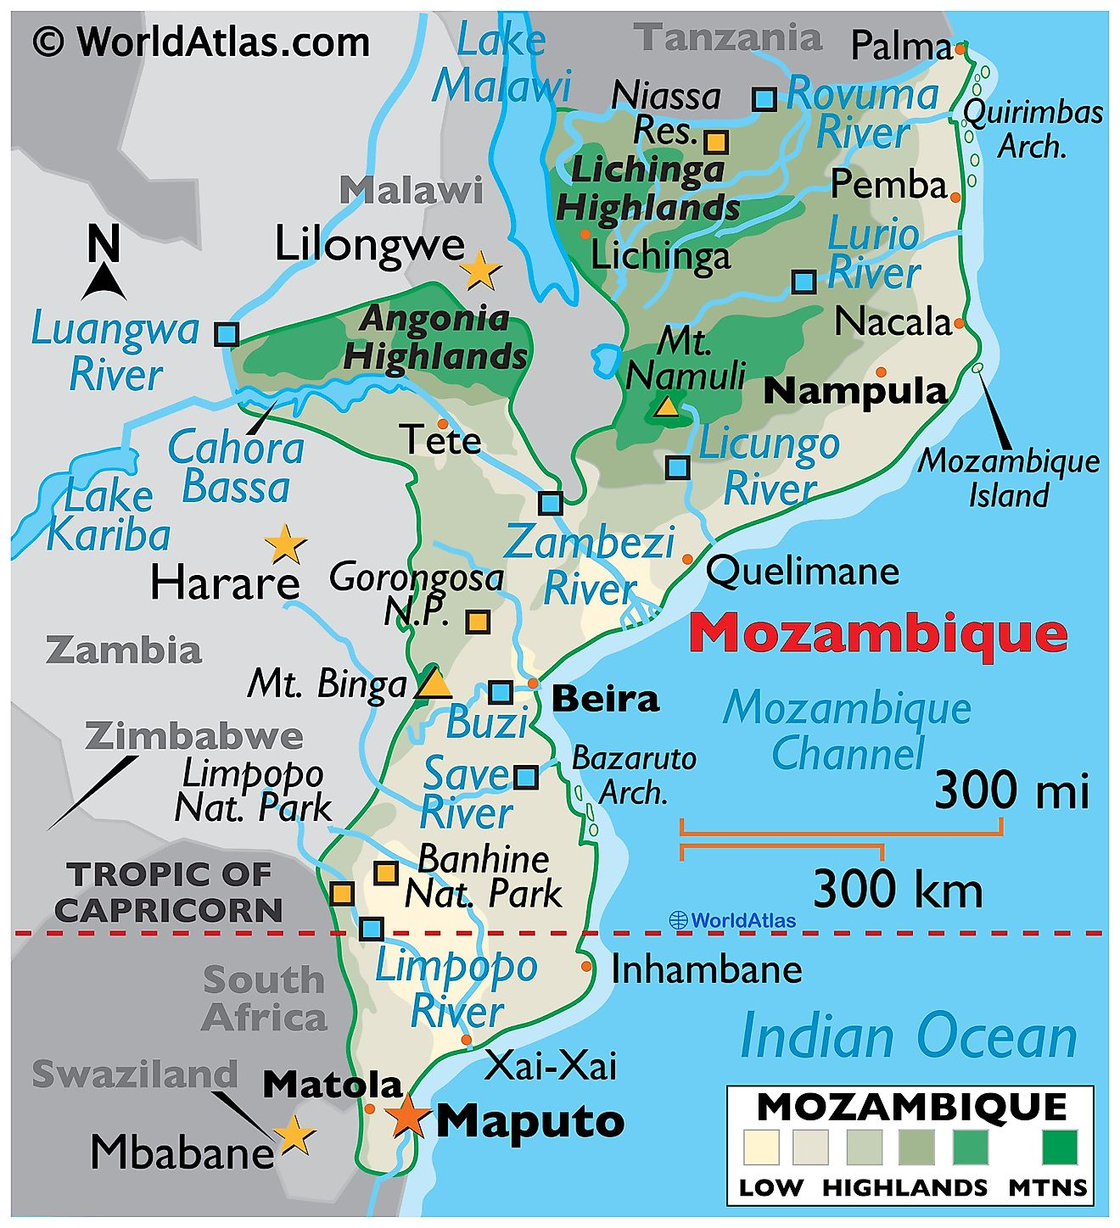
Mozambique
Producing region: Nacala, Nampula and Beira
Crushing quality
Exports to China and Japan
Transit Time main issue
2021 Crop is about 90/95,000 MT
Season June to August
Season already finished

Slide 7
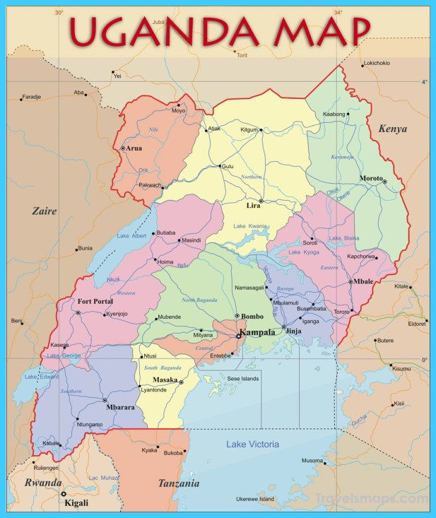
Uganda
Producing region : Lira and Anyanga
Crushing as well whitish quality
Trend says better or same crop
Main exports to China, Japan, Turkey
Last Year Estimate 20/25,000 MT

Slide 8
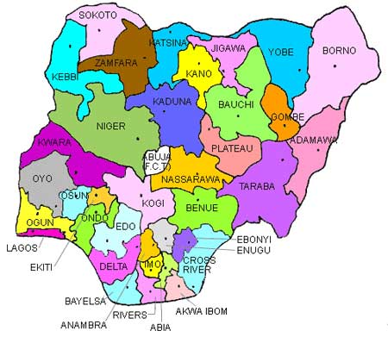
Nigeria
Producing areas: Kanoo, Laffia, Benue Taraba, Bauchi
Both white and mixed type available
Production about 300,000 MT
2021 crop expected same or better than last year
Main market: Japan, China, Turkey and Middle east
Logistics major issue
Exchange is main concern

Slide 9
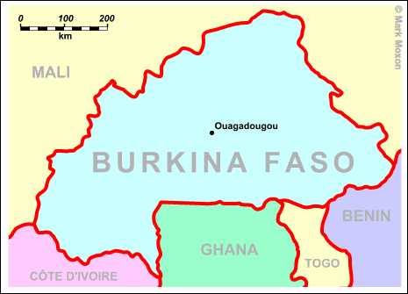
Burkina Faso/Allied
Main countries: Burkina, Mali, Togo, Senegal
Both whitish and mixed type
Main markets: China and Japan
Last year estimate: 200/210,000 MT
Burkina now dft but still not active
Crop to start from November

Slide 10
Africa Production

Slide 11
China Imports – Jan to Aug 2021

Slide 12
Trends and Current Stock
Tanzania
Crop started in June and was over in August.
Crop size 120-130,000 Mt
North type was affected by rains.
Quality per se was better than last year
Current stock pending for shipment.
Fortunately, not much Logistic issue at that time.
Price started from 1250 and went as high as 1350.Currently USD 1650+

Slide 13
Trends and Current Stock
Mozambique
Season started in July and went up to August/September
Crop size around 90,000 mt
Stock carry over Nil
Not much shipped till September and in fact still shipments are going on.
Carry over stocks are there.
Price range 1240 USD to 1680 USD

Slide 14
Trends and Current Stock
Nigeria
Crop started in September with Taraba and Bauchi has started coming in now.
General idea is short crop as farmer went to Soya and other crops
Season expected to go up to Feb 2022
Logistic still big issue with shortage of containers.
Currency variation
Price started with 1350 and has increased up to 1700 already.
Nigeria crop benefitted by the increase in freight at the India subcontinent in respect to Hulled Sesame market

Slide 15
Trends and Current Stock
Uganda
Prices started very high
Season just started and is very slow, expected to pick up pace from Dec 22
Burkina Faso
Season to start in November
Crop expected to be good
Crop Size expected 210,000 mt
Both white and mix available
Initial asking price Indications are towards higher side.
Logistic issue is expected to occur
Price not yet started in market

Slide 16
Trends and Demand
JAPAN
Buying position of Dec/Jan
Logistics issue of Nigeria – continuing
Prices range for this year around US 1250 levels to 1570 USD Currently
Import quantity is stable at 160K for the last few years
CHINA
Stock is now 210 as compared to highest of 300 k
China showed maturity and systematic buying
Currency appreciation
Niger /Sudan replacing Ethiopia as main supplier
Import quantity remains at 800K+
TURKEY/MIDDLE EAST
Import quantity remains at around 140K
Buying not in large quantity due to the lockdown impact on small seed demand

Slide 17
Future Direction of Market
Future depends on buying from China
Logistics issue remain a major concern and can add fuel to market
Currency fluctuation.
Reduced buying power everywhere.
Origins are firm and adamant after Corona time.

Slide 18
The contents of this presentation is based on information received from trade, unorganized sources, understanding and interpretation. It only represent observation and personal opinion and does not constitute for any business decision or to challenge any information or opinion.

Slide 19
PRARAMB NETWORK
TANZANIA
NIGERIA
MOZAMBIQUE
MALAWI
KENYA
UGANDA
BURKINA FASO
IVORY COAST
GUINEA BISSAU
RUSSIA
UAE
Emerging Re-Exporter of the year 2018

