Slide 1
Global Overview of Sesame Market.
Oct’ 2021
Tarun Chawla

Slide 2
Disclaimer
This presentation includes forward-looking statements and views. Because such statements and views deal with future events, they are subject to various risks and uncertainties and the way markets turn out could differ materially from our anticipations.
These statements made and forward looking views expressed in this presentation are merely for analysis of the market. These are not trading recommendations.
The Presenter and/or ETG cannot be held liable for any losses occurring to anyone by trading on these statements or views.

Slide 3
Contents
Global Trade: Major Origins
Northern Hemisphere: Crop Outlook
China & ROW demand
The Price Trend
Forward Outlook: Our View

Slide 4
Global Trade: Major Origins
Marketing Year: Oct to Sep
Global trade (Major origins) can shrink to 1.3 to 1.35 Million tons in 2021/22.
MY 20-21: Southern hemisphere supply reduced compared to last year.
India’s import & reexport viability is under pressure owing to higher freight costs.

Slide 5
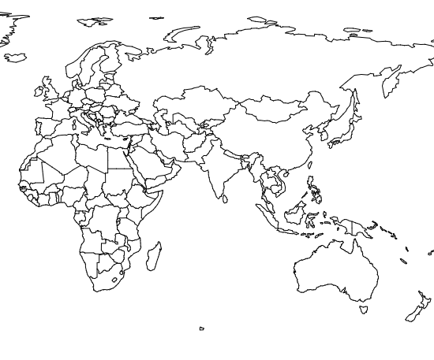
Northern Hemisphere Estimate : 2021-22
Change in Supply Numbers Expressed in Metric Tons.
China: -50k MT
Burkina Cluster:-40k MT
India:-20k MT
Nigeria:-60k MT
Sudan:-30k MT
Ethiopia: -50k MT
Northern Hemisphere (Major origins) supply is likely to shrink by -250k MT
India’s crop is likely to less than LY primarily owing to the rain damage.
West Africa return on other competing crops were better & hence Sesame lost acreage.
China’s local crop planting in Hubei, Anhui & Henan was also less because of better return to farmers in other crops.

Slide 6
China’s Demand
China’s Imports::
Trade Numbers Expressed in Metric Tons.
China’s imports in the current year is likely to be historic high of 1.05 M MT.
From Jan’21 to Sep’21 imports have already exceeded 2019 yearly import number.
Niger/Nigeria exports to China will be historic high this year.
Despite this, China port stocks can drop to 100k to 120k by Dec’21 closing.

Slide 7
ROW’s Demand
Rest of the World
Japan follows the sustainable supply model & imports 200k MT. Sesame oil demand has increased.
Turkey imports 50% from Nigeria & rest from Sudan & other origins for Tahini & re-exports.
Middle East region largely imports from Sudan, India & Ethiopia.
Europe’s demand can shrink & so will India’s exports to EU. African Hulled will continue to gain market share.
Korea: State tender contributes to 36k to 40k MT/Year & the rest is under a Private quota. Since 2016, 24k MT is under China FTA.
India’s import & re-export parity remains challenged.
The total demand of Processed & Natural Sesame for the rest of the world can
shrink owing to higher prices & short supply to 850k MT.

Slide 8
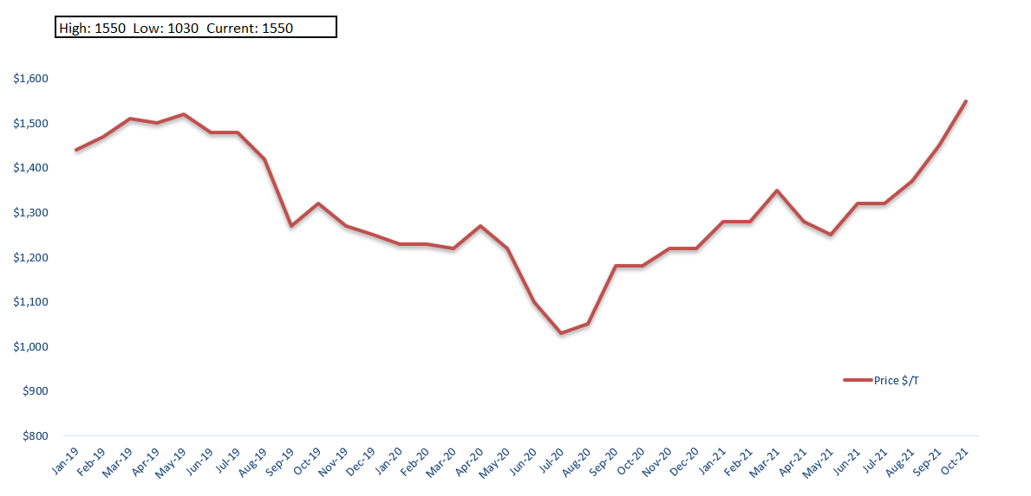
Crush Grade: Price Trend
Sesame lost acreage owing to lower returns & La Nina caused rain damage
Range Bound Market: Oct’19 till Mar’20
COVID: Sentiments
NOT Fundamentals
Price volatility owing to FIVE C’s: 1) China 2) Climate 3) Crop Returns &
4) Currency 5) COVID

Slide 9
Forward Outlook: Our View
Bullish Cues:
Second year in a row we have a La Nina conditions.
China, India, Ethiopia, Nigeria & Burkina crop shortages has been confirmed.
Higher logistics cost & port disruptions.
Bearish Cues:
COVID: Belt tightening owing to loss of income.
Demand substitution.
Sesame market outlook is Bullish & the same has reflected in the price surge & only demand substitution can put some cap on the prices, else we can witness 1600-1800 price range this season.

Slide 10
Thank You

