Slide 1

Global Grains and Ingredients
    2021
    The European Union
    &
    Sesame seed

Slide 2
Global Grains and Ingredients
    David Buttery
    CEO & Founder
    of
    Global Grains and Ingredients Ltd
    London, United Kingdom.

Slide 3

Global Grains and Ingredients
Margaret Keenan Dec 2020
Notes:
She is a 90 year old lady form England who was the first to be vaccinated against Covid-19 - we hope she is followed by the world !

Slide 4

Global Grains and Ingredients
Margaret Keenan - booster Oct 2021
Notes:
She is a 90 year old lady form England who was the first to be vaccinated against Covid-19 - we hope she is followed by the world !

Slide 5
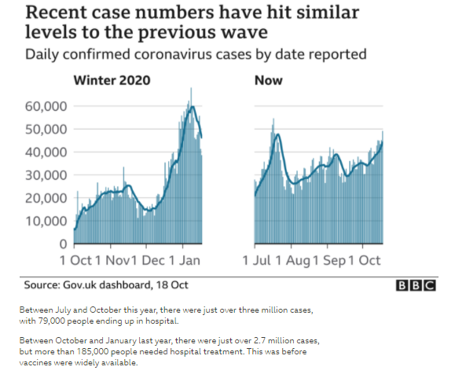
Global Grains and Ingredients
Notes:
Infections Rising here in the UK

Slide 6
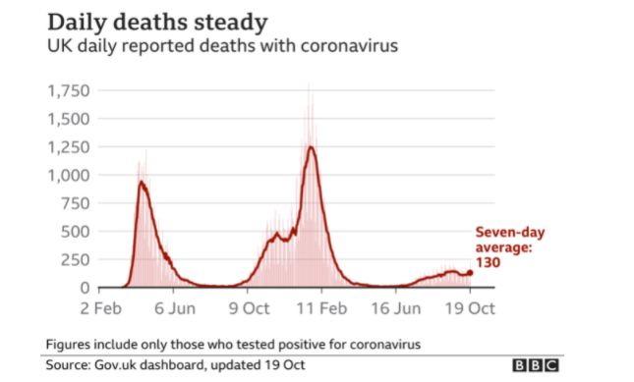
Global Grains and Ingredients
Notes:
Daily deaths at 10% of the peak.

Slide 7
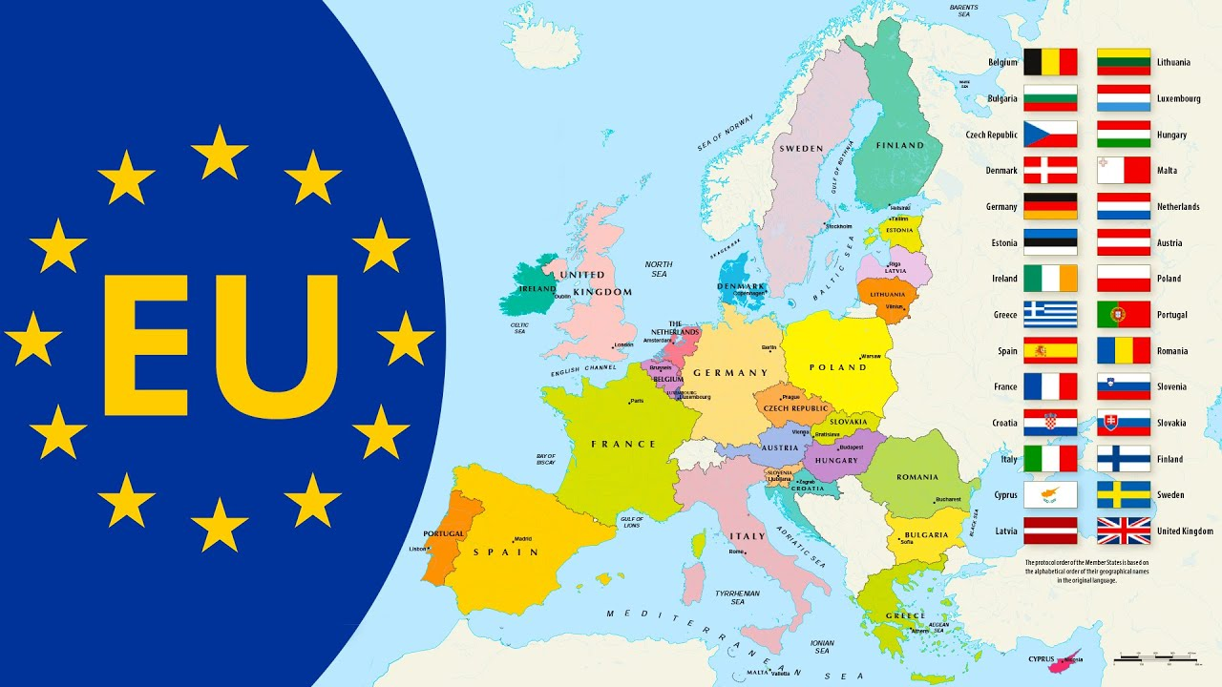
Global Grains and Ingredients
Notes:
Lets get on with Sesame

Slide 8
Global Grains and Ingredients
Comments from the EU commission, that can be shared with the sesame seed community.
• The Commission follows closely the issue of EtO with the competent authorities of India to discuss the action plan and the follow-up of the measures put in place by India to remedy the contamination of sesame seeds with ethylene oxide.
• India has committed to implement all EU-mandated measures on sesame seeds and spices, fruits and vegetables and continues to work on identifying the source of contamination.
• India has taken satisfactory corrective actions, supported by the results of official controls on sesame seed consignments exported from India, upon their entry into the EU since January 2021. But they should continue their efforts to be sure that all exports of SS are free of EtO.
• In addition, the Commission has asked the Indian authorities to test spices and fruits and vegetables to ensure that they comply with EU regulations.
• The Commission is following this issue closely with Member States.
It may be interesting to get more information on the origin of EtO found in different commodities, which to date was not clearly identified.
• A next follow-up meeting with India is scheduled for November 2021.
• For more information, please visit: https://ec.europa.eu/food/safety/rasff/ethylene-oxide-incident_en
Notes:
ETO still a big focus in the EU. I have engaged with the DG Sante have their agreement to share these words with our sesame community.

Slide 9

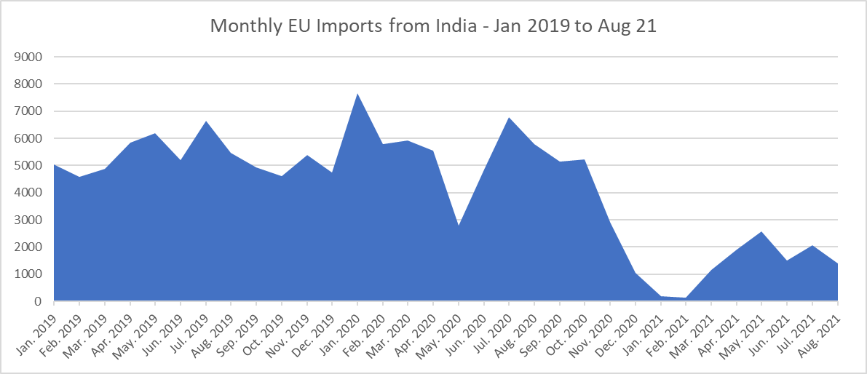
Global Grains and Ingredients
ETO Impact Dec 2020
Notes:
Here we can see the impact on Indian sesame seed imports into Europe – Imports - recovery at less than 50% of previous monthly levels.

Slide 10
Global Grains and Ingredients
2020 - €214,232 - 129,212mt
Notes:
Eu sesame imports - tonnage down in 2020 and values lower.

Slide 11
Global Grains and Ingredients
Annual EU imports - kgs
Notes:
Top suppling origins in descending order for 2020. highlighted in Yellow are the origins that increased their volumes over 2020. Turkey , China , Paraguay and Brazil increasing their share.

Slide 12
Global Grains and Ingredients
Notes:
Average price per MT for the past 2 years… , every origin, except Uganda, suffering lower prices per MT.

Slide 13
Global Grains and Ingredients
2020 – India / Nigeria / Sudan / TURKEY (7,656mt) / Ethiopia
Notes:
Turkey have edged Ethiopia out of the big 5 EU Suppliers in 2020 with over 7000mt

Slide 14
Global Grains and Ingredients
Notes:
EU Stats are collated differently in 2020 by the commission, but the Order market consumption is unchanged.

Slide 15
Global Grains and Ingredients
All foods sold in the EU must comply with the EU Regulations.
RASFF – the Rapid Alert System for Food and Feed. https://ec.europa.eu/food/safety/rasff_en
EU Regulations. – related to Food safety.
Notes:
reminder to any new exporters intending to ship to the EU.

Slide 16
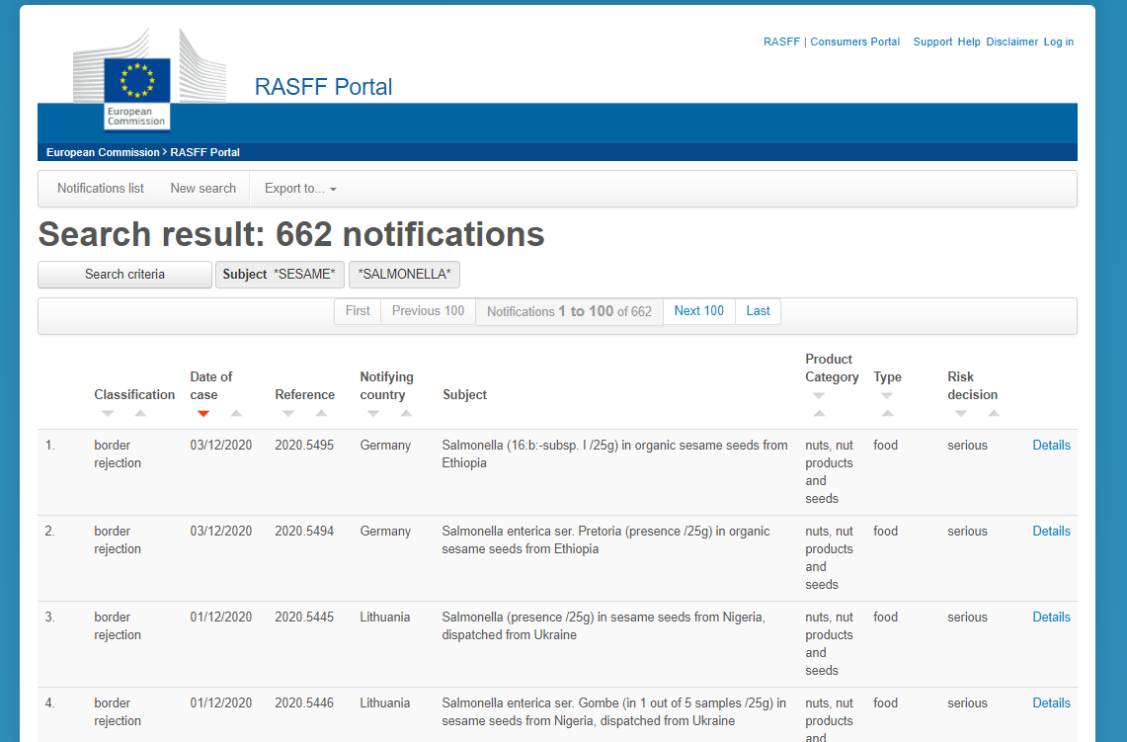
Global Grains and Ingredients
Notes:
Please continue to check the rapid alert portal to be up to date with emerging issues.

Slide 17
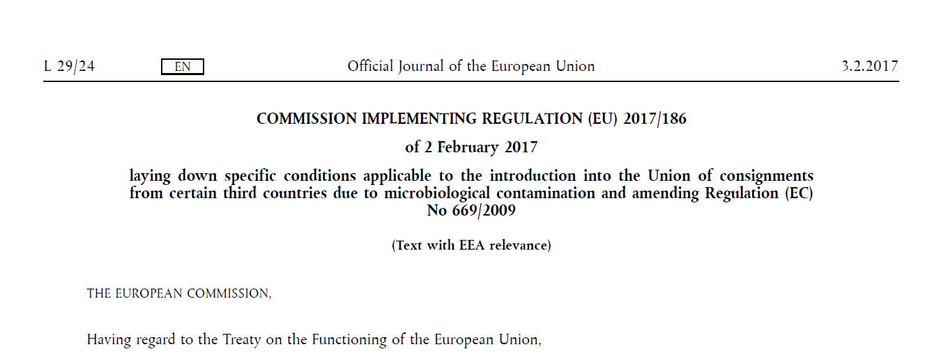
Global Grains and Ingredients
Notes:
A reminder of the EU Regulations impaction Sesame

Slide 18
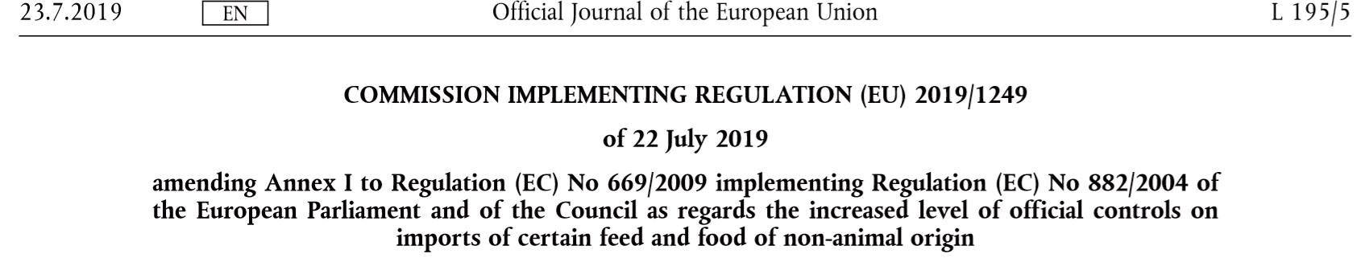
Global Grains and Ingredients

Slide 19
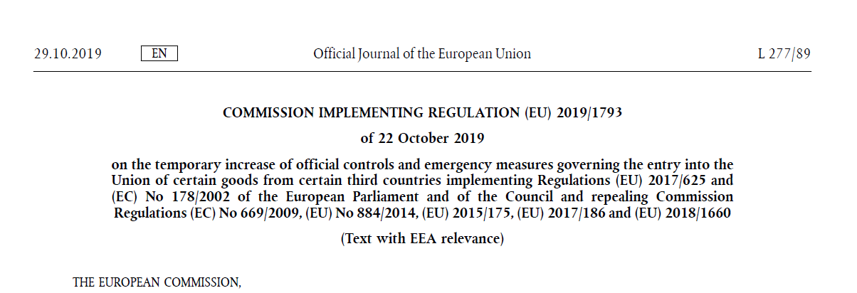
Global Grains and Ingredients
Notes:
This regulation an increase in official controls and called for 20% if Indian arrivals + 50% of Nigerian + Sundanese + Ugandan + Ethiopian seed to be tested on arrival

Slide 20
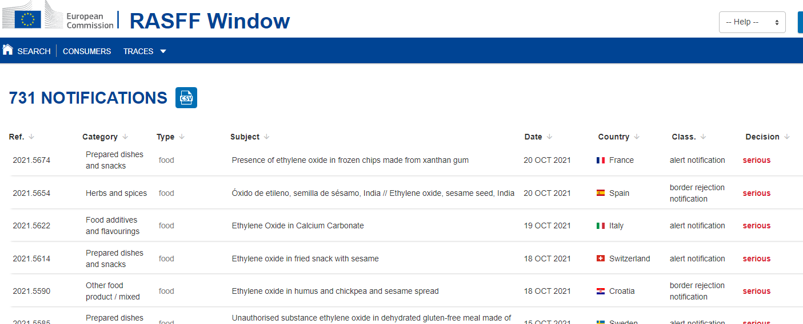
Global Grains and Ingredients
Notes:
ETO Notifications have reach 731 !!

Slide 21
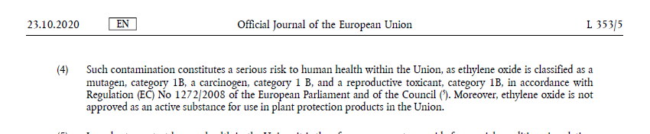
Global Grains and Ingredients
Notes:
Why are the EU so concerned about ET O = Extract of the regulation as to why the EU is taking this action

Slide 22
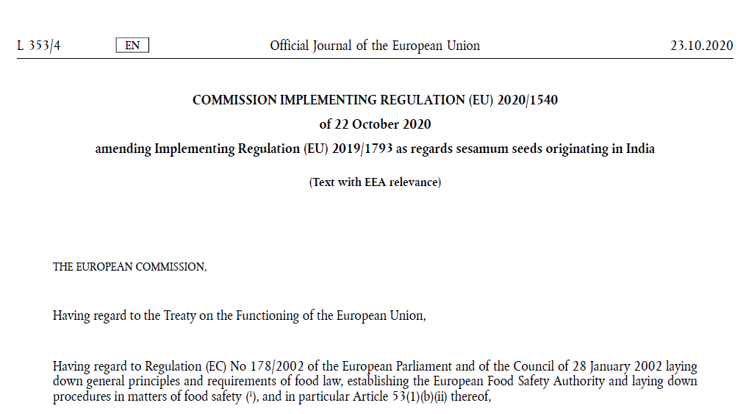
Global Grains and Ingredients
Notes:
The NEW ETO REGULATION -

Slide 23
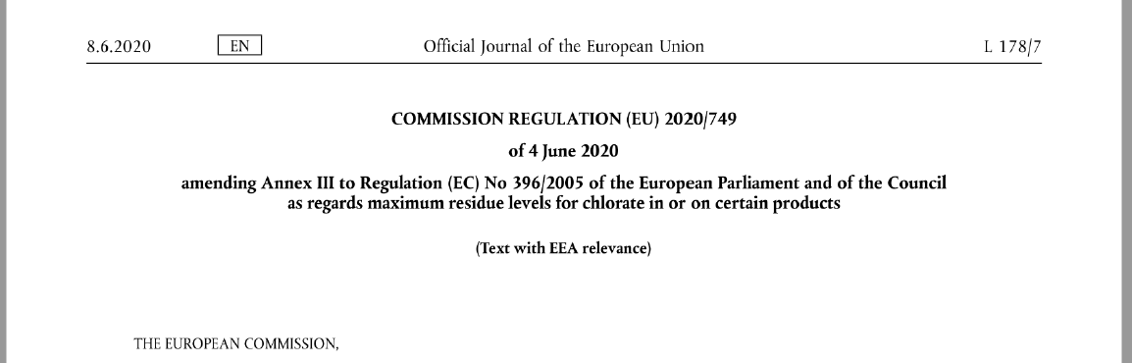
Global Grains and Ingredients
Notes:
Sources are Pesticides and water treatments.

Slide 24
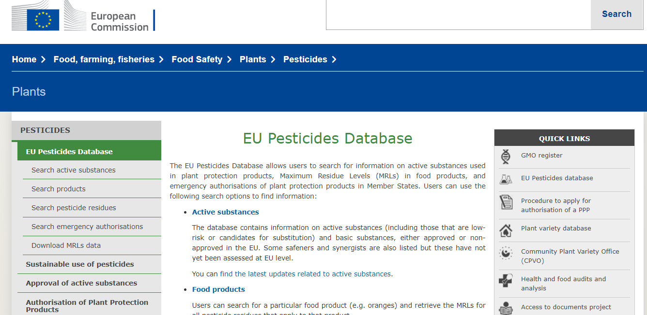
Global Grains and Ingredients
https://ec.europa.eu/food/plant/pesticides/eu-pesticides-database/public/?event=homepage&language=EN

Slide 25
Global Grains and Ingredients
EUROPE & UK WANT

Slide 26

S T O K E S
S afe and compliant food
T hat grows our market
O rganically and is
K ind to the environment,
E thically produced and from
S ustainable sources.

Slide 27
Global Grains and Ingredients
THANK YOU.
David Buttery
Global Grains & Ingredients Ltd,
Capitol House,
60-62 Leman street,
London
E1 8EU
Telephone : +44 (0) 207 488 6868
email – Info@globalgrains.co.uk

