Slide 1

LATAM Sesame Seed Market Outlook
Suhel Turjman

Slide 2
Disclaimer
“The opinions expressed in this presentation and on the following slides are solely those of the presenter. The presenter does not guarantee the accuracy or reliability of the information provided herein .”

Slide 3
Brazil Sesame Exports

Slide 4

Year-on-year exports
 | Column Labels
 | 2020 |  |  |  | 2021
Month | Kgs | Value (USD) | Avg. Price (per kg) | Kgs | Value (USD) | Avg. Price (per kg) | Delta (%)
Jan | 610,793.00 | 788,286.00 | 1.29 | 3,688,350.00 | 3,744,933.00 | 1.02 | 504%
Feb | 256,069.00 | 335,787.00 | 1.31 | 2,660,232.00 | 2,972,575.00 | 1.12 | 939%
Mar | 205,087.00 | 256,532.00 | 1.25 | 2,699,429.00 | 2,846,332.00 | 1.05 | 1216%
Apr | 453,794.00 | 541,865.00 | 1.19 | 5,275,487.00 | 5,929,209.00 | 1.12 | 1063%
May | 148,898.00 | 156,588.00 | 1.05 | 2,121,794.00 | 2,342,564.00 | 1.10 | 1325%
Jun | 694,447.00 | 747,939.00 | 1.08 | 1,357,824.00 | 1,347,965.00 | 0.99 | 96%
Jul | 7,434,256.00 | 7,852,916.00 | 1.06 | 1,948,914.00 | 2,165,354.00 | 1.11 | -74%
Aug | 13,369,278.00 | 13,416,814.00 | 1.00 | 2,682,290.00 | 3,193,824.00 | 1.19 | -80%
Sep | 9,860,472.00 | 9,382,549.00 | 0.95 | 2,570,489.00 | 3,195,051.00 | 1.24 | -74%
Oct | 13,837,628.00 | 12,590,714.00 | 0.91 |  |  | #DIV/0!
Nov | 13,163,008.00 | 12,603,756.00 | 0.96 |  |  | #DIV/0!
Dec | 11,966,312.00 | 11,629,414.00 | 0.97 |  |  | #DIV/0!
Grand Total | 72,000,042.00 | $ 70,303,160.00 | 0.98 | 25,004,809.00 | $ 27,737,807.00 | 1.11 | 14%

Slide 5
Key takeaways:
Expected decrease in crop size of 35% versus 2020 season. Total crop = 55,000 – 60,000 MTs.
Competing crops (corn) and lower effective yields.
Exporters are achieving higher international prices.
Big logistical challenges (higher freight costs and lack of container boxes).

Slide 6

Paraguay Sesame Exports

Slide 7
Paraguay year-on-year exports
 | 2020 |  | 2021
Month | Sum of Kgs. Netos | Sum of U$S FOB | Sum of Kgs. Netos | Sum of U$S FOB
Jan | 300,156.00 | $ 490,669.20 | 1,228,527.30 | $ 1,874,533.98
Feb | 554,730.20 | $ 1,016,746.79 | 1,169,452.80 | $ 1,832,440.35
Mar | 718,366.00 | $ 1,140,154.83 | 1,599,699.60 | $ 2,549,835.86
Apr | 4,740,548.50 | $ 7,351,732.52 | 4,387,685.91 | $ 5,970,681.91
May | 5,537,343.40 | $ 7,959,423.91 | 5,395,522.00 | $ 7,355,972.64
Jun | 7,546,278.00 | $ 10,613,149.40 | 10,239,238.00 | $ 15,075,459.12
Jul | 7,343,307.48 | $ 10,660,978.12 | 3,077,014.40 | $ 4,666,676.06
Aug | 4,931,490.00 | $ 7,695,929.70 | 1,758,980.00 | $ 2,505,172.30
Sep | 2,927,468.98 | $ 4,330,865.73
Oct | 2,698,210.85 | $ 4,246,419.49
Nov | 2,085,109.71 | $ 2,942,896.73
Dec | 3,796,742.66 | $ 5,176,382.52
Grand Total | 43,179,751.78 | $ 63,625,348.94 | 28,856,120.01 | $ 41,830,772.22

Slide 8
Key takeaways:
Lower crop size versus previous season = 30% decrease.
Unpredictable weather and crop quality.
Differentiated crops (confectionary vs crushing types).
Huge logistical challenges.

Slide 9
Year-on-year imports
Month | 2020 (kgs) | 2021 (kgs) | Deficit
Jan | 1,465,514.17 | 1,042,625.68 | (422,888.49)
Feb | 1,840,440.00 | 1,004,660.62 | (1,258,667.87)
Mar | 2,170,239.63 | 908,242.37 | (2,520,665.13)
Apr | 2,107,165.60 | 1,350,269.42 | (3,277,561.31)
May | 4,309,464.99 | 1,501,717.33 | (6,085,308.97)
Jun | 4,529,828.10 | 2,888,500.69 | (7,726,636.38)
Jul | 6,790,409.87 | 3,141,852.81 | (11,375,193.44)
Aug | 4,654,687.10 | 3,843,773.20 | (12,186,107.34)
Sep | 4,486,554.83
Oct | 3,524,359.11
Nov | 2,190,761.36
Dec | 674,906.35
Grand Total | 38,744,331.11 | 15,681,642.12

Slide 10
Year-on-year exports of sesame products
Product | 2020 (kgs) | 2021 (kgs) | 2020 natural throughput (kgs) | 2021 natural throughput (kgs)
Hulled sesame seed | 7,130,349.17 | 4,419,525.50 | 8,695,547.77 | 5,389,665.24
Natural sesame seed | 4,240,681.81 | 4,575,956.15 | 4,463,875.59 | 4,816,795.95
Sesame seed oils | 15,076,289.79 | 10,000,363.89 | 28,992,864.98 | 19,231,469.02
Tahini | 13,059,847.35 | 10,364,371.93 | 16,960,840.71 | 13,460,223.29
Total | 39,507,168.12 | 29,360,217.47 | 59,113,129.05 | 42,898,153.50
Note: Natural throughput = natural seed used to process products
*Assumptions: 18% hulling manufacturing loss, 5% natural loss, 23% tahini manufacturing loss 52% oil extraction rate.
Exports of sesame product are to Aug. 2021.

Slide 11
Local Production
State | Harvested area (hectares) |  | Production (MTs)
 | 2019 | 2020 | 2019 | 2020 | 2021?
COLIMA | 172 | 4 | 114 | 4
CHIAPAS | 15 | 7,844 | 14 | 4,240
GUERRERO | 7,956 | 14,931 | 4,142 | 13,415
JALISCO | 12,057 | 1,292 | 10,166 | 625
MICHOACAN | 1,064 | 8,988 | 478 | 5,894
OAXACA | 7,036 | 8,033 | 4,573 | 6,057
PUEBLA | 7,861 | 80 | 5,716 | 126
SAN LUIS POTOSI | 60 | 30 | 59 | 16
SINALOA | 23,487 | 18,153 | 17,670 | 11,220
SONORA | 787 | 1,397 | 264 | 835
TAMAULIPAS | 661 | 1,755 | 387 | 556
VERACRUZ | 303 | 300 | 446 | 445
TOTAL | 61,460 | 62,806 | 44,030 | 43,432 | ??
Lack of survey data of sowed area for 2021.
Farmer’s planted alternative crops due to low prices.
Weather related issues could result in a decrease crop size for 2021.
Source: Elaborated by the Servicio de Informacion Agroalimentaria y Pesquera (SIAP).

Slide 12
Key takeaways:
Mexico is LatAm’s leading exporter of sesame products and its largest importer of natural seed.
Competing crops (corn), weather issues and lower effective yields could reduce the size of the upcoming crop.
Import/export data would suggest an imbalanced balance sheet.
Sizeable domestic demand could see a chunk of local production taken out of export markets.
Increasingly challenging import logistics but excellent outbound opportunities.

Slide 13
Guatemala -
Crop size average between 11-000 - 12,000 MTs Nov-Dec.
Premium markets for natural seed in Japan and for hulled in U.S.A and Europe.
Premium confectionary product destined for Japan.
Manual harvest and good agricultural practices.

Slide 14
Venezuela:
Farmer’s have opted to sow green mung beans at the expense of sesame seed.
The 2021 crop was very small – no more than 4,500 MTs.
Lack of farming inputs (especially diesel) has decimated farming in the country.
We can safely say that the collapse of Venezuela as a sesame exporting nation is complete.

Slide 15
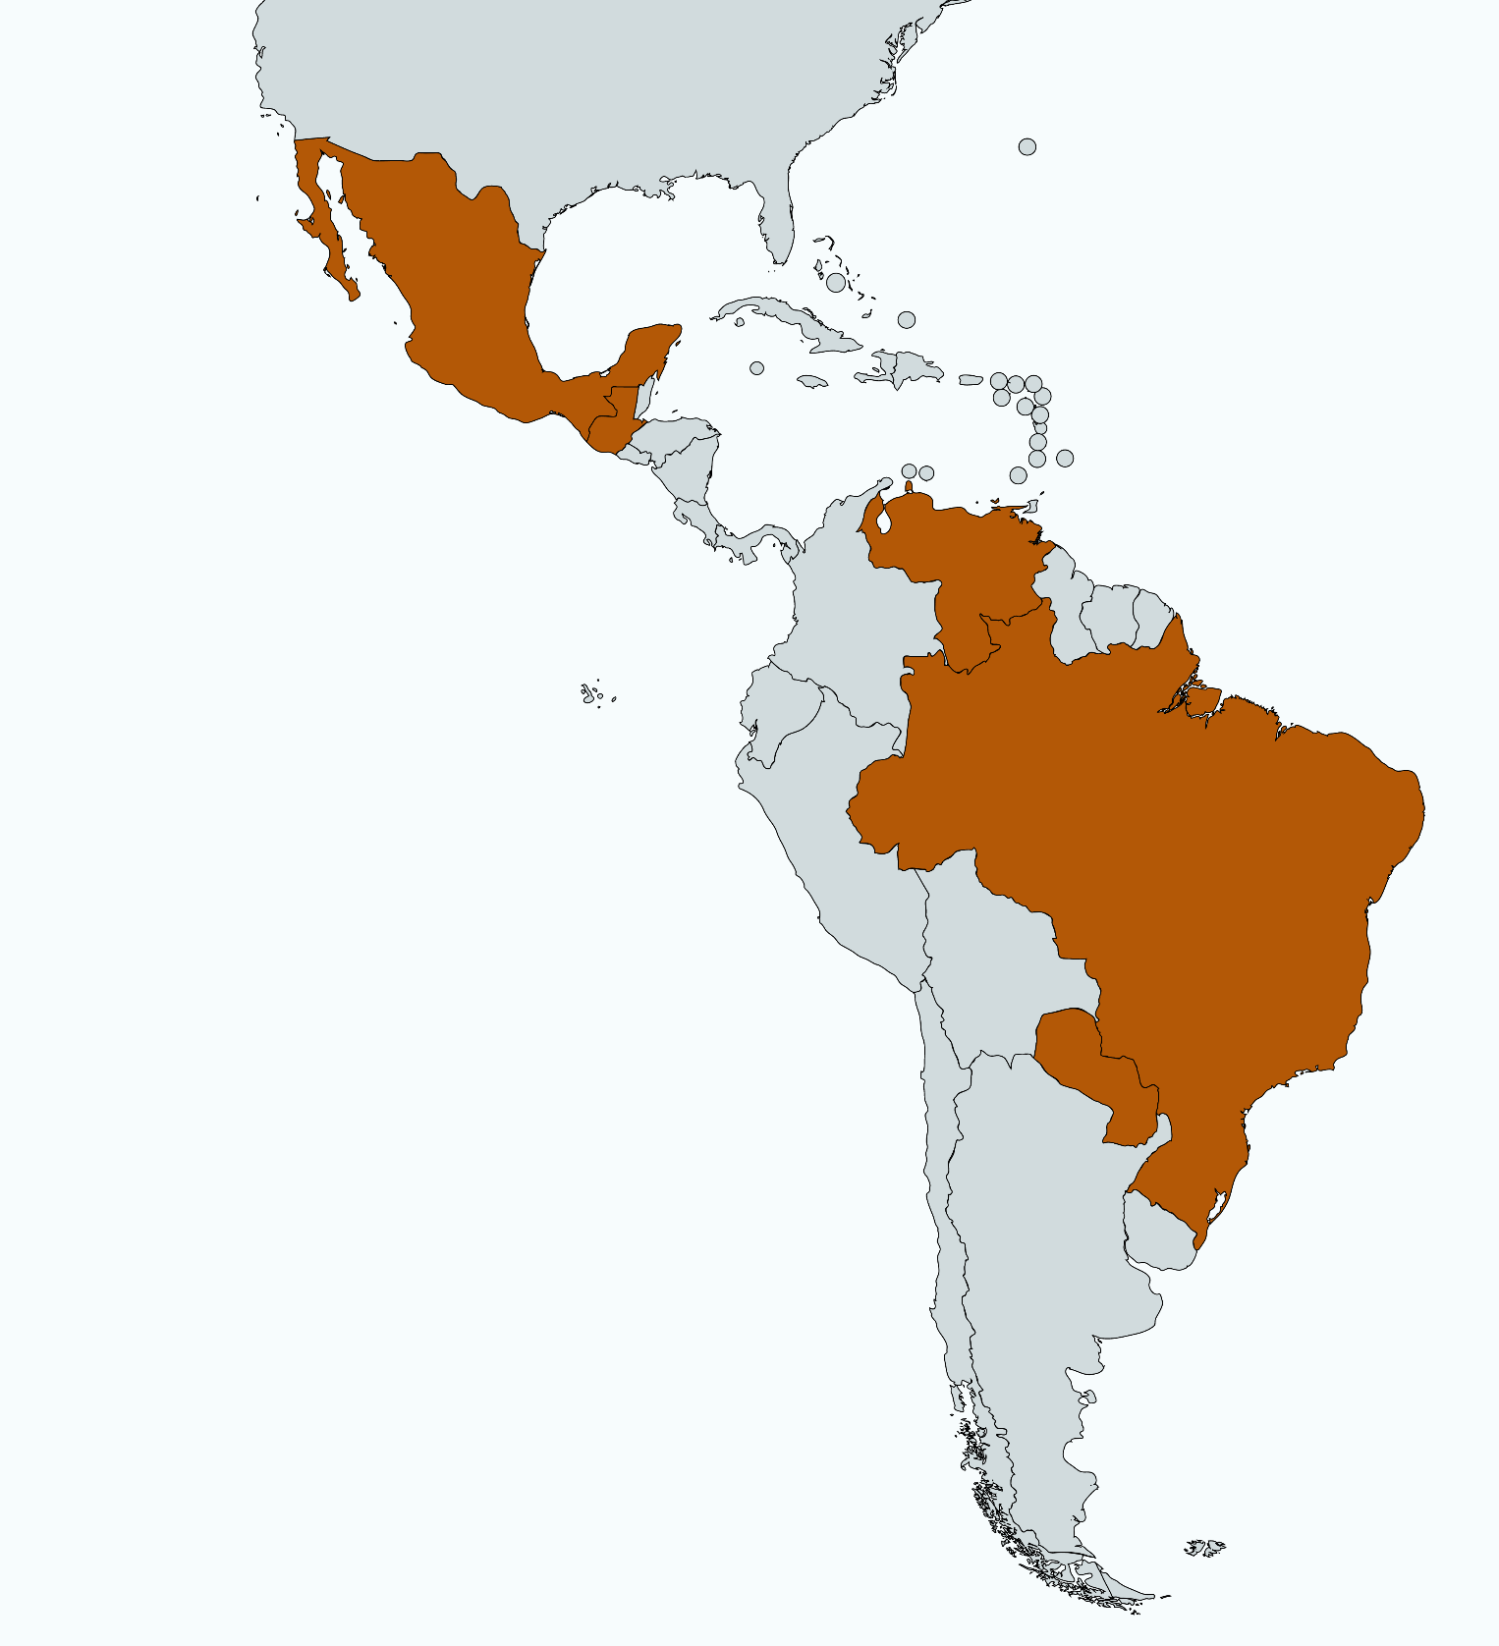
Recap and general trends
General planting areas have decreased year-on-year.
Competing crop prices have disincentivized sesame production.
Is Brasil the global swing producer we hoped?
Most countries are facing logistical challenges but also some opportunities.
Total LatAm production does not exceed 150,000 MTs.

