Slide 1



S&D Analysis
African Sesame
Trade Outlook
Dt. 21st Oct 2021 ,Location: India

Slide 2



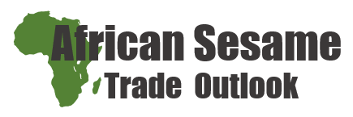
Safe Harbour Statement
‘
This presentation includes forward-looking statements and views. Because such statements and views deal with future events, they are subject to various risks and uncertainties and the way markets turn out could differ materially from our anticipation.
These statements made and forward-looking views expressed in this presentation are merely for analysis of the market. These are not trading recommendations.
The Presenter and/or Olam International (and/or any subsidiary company of Olam International Ltd) can not be held liable for any losses occurring to anyone by trading on these statements or views.
’

Slide 3





Contents:
African origins trade
African 20-21 crop overview
& 21-22 crop estimates
Price trends & China port stock
New season forward
Our view

Slide 4
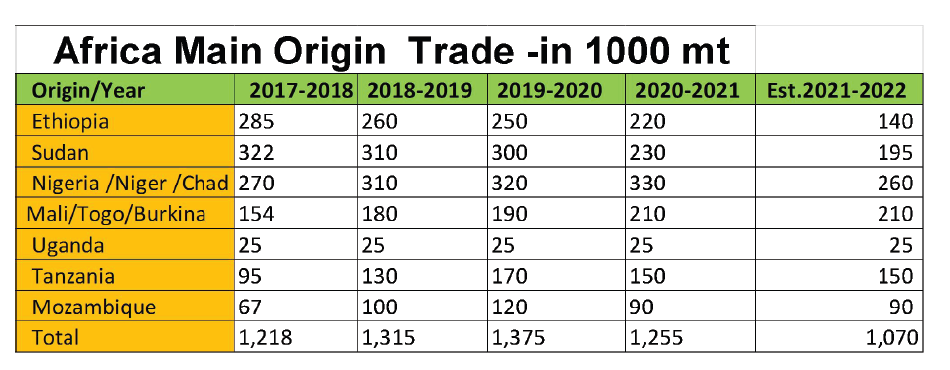
African origins trade
Africa trade (Major origins) is likely to be 1.07 Mln tons in 2021-2022, less than crop year 2020-2021
Tan + Moz; continue increased in last 4-5 years, but seems to have changed in 2021 year.
Too early to comment on the 2022 crops

Slide 5









African Highlights of CY 21-22 vs 20/21
  Nigeria/Niger: Plant reduced and shift to soybean/rice/corn etc, crop delay, farmer hold cargo and currency depreciation
  Ethiopia: Plant reduced lot in white seeds area for food security and political issues
  Sudan: Plant reduced lot for food security ,currency depreciation,
  crop delay and port issues
  Mali + Togo + Burkina: Similar as last season
  Similar as last season ? Tanzania + Mozambique ?

Slide 6

Price trend
June 30，2021
  ^Price affecting events:
  Reduction is China’s domestic crop
  Tn & MQ – Crop delays & reduction
  Shipment delays from East Africa
  China - Myanmar border closure

Slide 7

China port stock
200,000 MT+ port stock is normal status in China
Qingdao has become biggest sesame warehouse + Super cleaning + Sortex concentrate place in the world
The price change has no consequent relations with port stock , especially in current 4/5 years

Slide 8

New Season forward
China: Total crop reduced 30% + than last season
India: Crop reduced than last year due to rain & less sowing
  Nigeria: Crop reduced around 20%
  Sudan: Crop reduced around 15%
  Mali + Togo + Burkina: Similar as last season
  Ethiopia : Crop reduced around 30%
  Similar as last season ? Tanzania + Mozambique ?

Slide 9


Our View
Bullish Cues:
China; Price driver - consumption have NOT reduced
Japan should import more in FY-22 as they have reduced stock in FY-21
Indian crop shortage may lead to imports from Africa
The world consumption continue back from covid influence .
African new crop is less than last season .
Supply chain is very weak due to higher sea freight /port issue etc.
Shipment delays expected, Sudan port blockage & Equipment shortage
Bearish Cues:
High stock in China port: 200-210 KMT
New waves / new variants could put a cap on demand
Possible Supply pressure: as shipments might not go through & cash constraints could be felt in origins
Processed sesame market is shrinking after ETO episode, alternate products are gaining space
Pakistan’s excess crop and vicinity to China
‘
’
Supply to remain little tight, any supply disruption may lead to ….

Slide 10

Thanks
Thanks !
Wishing everyone a successful & profitable Sesame season ahead !
  ^Stay Safe !

