Slide 1
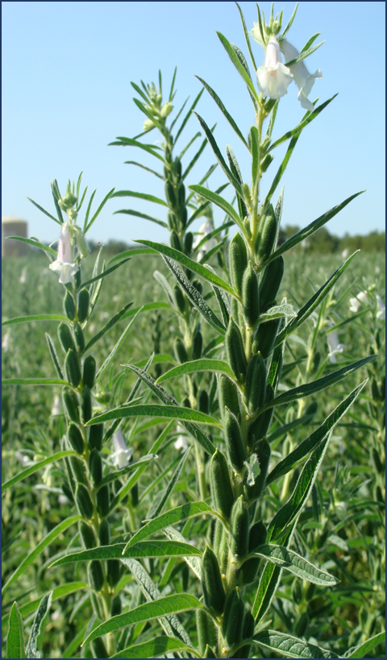
IOPEPC Global Oilseeds Conference (21 October 2021)
Jay Chandarana
Co-Convener, IOPEPC Sesame Panel

Slide 2
Nodal body for promotion and development of exports
Issues Certificate of Export for Sesame seed to EU
Issues Official (health) Certificate as per EC legislation
More than Six Decades of Service to Oilseeds & Oils Industry
Activities undertaken by IOPEPC
Oilseed Crop Survey
Export Awards
Provide Market Intelligence
Capacity building programs
Regional Annual meets
Arbitration for all contracts
Farmer camps on GAP Awareness
Issuance of Non-Preferential COO

Slide 3
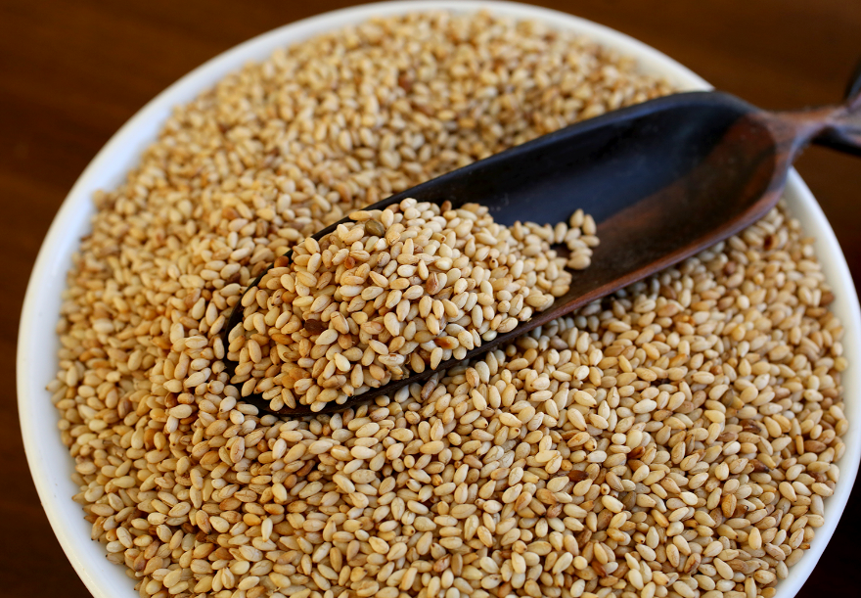
Sesame & India
Sesame is one of the oldest indigenous crops and is the fourth most important annual oilseed crop of India
Sesame seeds are valued for their health properties, edible oil and protein as being promoted by IOPEPC & the trade
India is amongst the top three sesame producing and exporting countries in the world

Slide 4
Overview of Indian Sesame seed Scenario
India is largest sesame seed producer in the world with production of 7,00,000 – 8,00,000 tons per annum.
Varieties grown in India include White, Black, Yellow, Brown black. These are available round the year.
Top Indian States producing sesame include West Bengal, Rajasthan, Madhya Pradesh, Gujarat. The time of harvest and type/quality of seed varies in different states.
India has well developed Sesame seed hulling industry with a capacity of 2,50,000 tons per annum
India also processes and exports raw and refined Sesame seed oil in bulk and small packing.

Slide 5
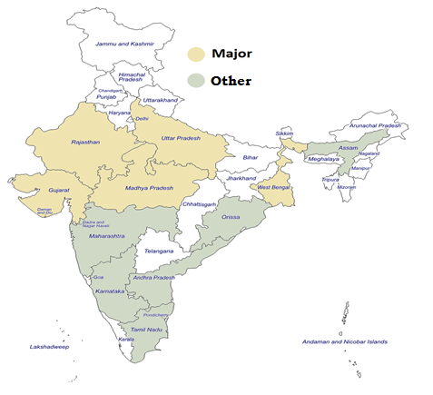
Sesame growing States & Harvest period
Crop | Harvest Period
Winter | October-December
Pre-Summer* | January-February
Summer | April-June
Post-Summer* | July-August
* Very small quantities arrive during this period

Slide 6
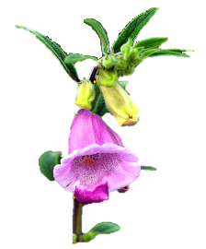
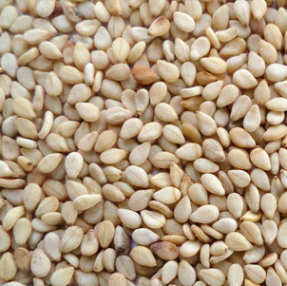
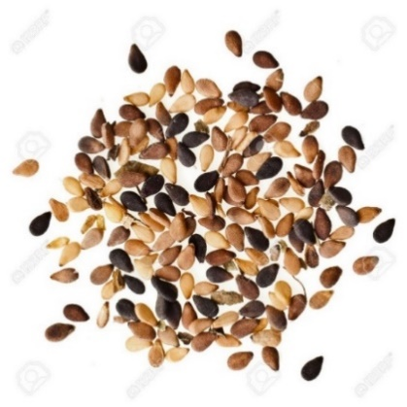
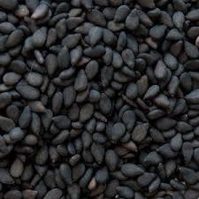
Indian Sesame: Seed Colour Diversity
Ninety varieties notified
About 30 varieties in seed chain
No Hybrid
No GM

Slide 7
Global vis-à-vis Indian Scenario
Parameter | World | India | % of Total
Acreage (Mn. ha) | 9.1 | 1.5 | 16.48
Production (MMT) | 5.94 | 0.80 | 13.00
Exports (MMT) | 2.41 | 0.30 | 12.00
Source: Oil World, 2021

Slide 8
India’s Production and Exports of Oilseeds (2020-21)
Oilseed | Production (tons) | Export (tons) | % of export against production
Groundnut (kernel) | 7083300 | 638580 | 9.02
Sesame | 792000 | 273130 | 34.49
Soya-bean | 13400000 | 68590 | 0.51
Rapeseed/mustard | 9987000 | 56560 | 0.57
Niger | 39000 | 19590 | 50.23
Linseed | 111000 | 11940 | 10.76
Safflower | 48000 | 3980 | 8.29
Sunflower | 281000 | 1330 | 0.47
 | 31741300 | 1073700 | 3.38
Source: MOC/ Trade

Slide 9
Increase in Oilseed Exports (000 Tons)
Sl.No. | Oil seed | 2019-20 | % Share (2019-20) | 2020-21 | % Share (2020-21)
 |  | Qty. |  | Qty.
1 | Groundnut | 664.44 | 61.34 | 638.58 | 59.43
2 | Sesame seed | 282.26 | 26.05 | 273.13 | 25.42
3 | Soya-bean | 74.67 | 6.89 | 68.59 | 6.38
4 | Mustard / Rapeseed | 31.78 | 2.93 | 56.56 | 5.26
5 | Niger seed | 13.83 | 1.27 | 19.59 | 1.82
6 | Linseed | 12 | 1.10 | 11.94 | 1.11
7 | Safflower seed | 2.61 | 0.24 | 3.98 | 0.37
8 | Sunflower seed | 1.2 | 0.11 | 1.33 | 0.12
9 | Cottonseed | 0.38 | 0.35 | 0.74 | 0.07
 | Total | 1083.17 | 100 | 1074.44 | 100
Source: DGCIS/MOC (April-March)
India is one of the largest exporter of Sesame seeds in the world.

Slide 10
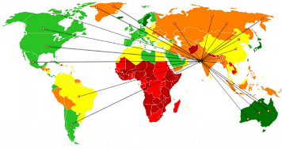
Details of Indian Sesame seed Exports (Tons)
Year Apr-Mar | Qty. (tons)
2020-21 | 2,73,126
2019-20 | 2,82,257
2018-19 | 3,12,003
2017-18 | 3,36,840
2016-17 | 3,08,993
2015-16 | 3,28,456
2020-21
Exports to 145 countries
Top ten destinations
South Korea, USA, Russia, Taiwan, Vietnam, Israel, China, Greece, Indonesia and Egypt

Slide 11
Top Importers of Indian Sesame seed (Tons)
Sl. No. | Country | 2019-20 | Share % | 2020-21 | Share %
 |  | Qty | 2019-20 | Qty | 2020-21
1 | European Union | 70,294.00 | 24.90 | 43,835.00 | 16.05
2 | Korea | 19,395.03 | 6.87 | 39,781.30 | 14.57
3 | U S A | 19,391.23 | 6.87 | 23,607.64 | 8.64
4 | Russia | 14,359.91 | 5.08 | 13,446.32 | 4.92
5 | Taiwan | 12,047.46 | 4.26 | 12,434.65 | 4.55
6 | Vietnam | 16,092.93 | 5.70 | 10,683.96 | 3.91
7 | Israel | 9,073.99 | 3.21 | 9,220.39 | 3.38
8 | China | 1,894.45 | 0.67 | 8,686.24 | 3.18
9 | Greece | 11,835.58 | 4.19 | 8,485.99 | 3.11
10 | Indonesia | 10,235.36 | 3.62 | 8,353.13 | 3.06
 | Others | 97637.52 | 34.59 | 94591.86 | 34.63
 | Total | 282,257.46 | 100 | 273,126.48 | 100
Source MOC
Exports to more than 145 countries.

Slide 12
Estimated composition of different varieties of Sesame seeds exported from India
Tons
Variety | 2020-21 | 2019-20 | 2018-19 | 2017-18 | 2016-17
Natural whitish | 58,000 | 60,000 | 65,000 | 1,05,000 | 95,000
Hulled | 1,88,500 | 1,95,000 | 2,15,000 | 2,00,000 | 1,85,000
Crushing quality | 23,000 | 24,000 | 24,000 | 26,000 | 20,000
Black | 3,000 | 3,000 | 5,500 | 5,000 | 7,000
Golden Yellowish | 500 | 500 | 500 | 500 | 400
Source: Trade
April-March

Slide 13
Indian Import of Sesame seed
2020-21 | 2019-20 | 2018-19 | 2017-18 | 2016-17 | 2015-16 | 2014-15
100173 | 145741 | 75092 | 26270 | 69028 | 23597 | 34768
Source: MoC
April-March
During 2020-21 India imported Sesame seed mainly from Sudan, Brazil and Nigeria

Slide 14
India's Export of Sesame oil (Tons)
Share in Global Prod’n ≈ 10.6%
Share in Global Exports ≈ 22.18%
Extent of Prod’n Exported ≈ 11.48%
2021-21:Total 109 destinations
Major (>1000 T) importers
Mexico, USA and UAE
Year | 2020-21 | 2019-20 | 2018-19 | 2017-18 | 2016-17 | 2015-16
Quantity | 11023 | 9752 | 9940 | 9452 | 9735 | 7762
Source: MoC
April-March

Slide 15
Constraints in Enhancing & Sustaining Exports
Technical Barriers to Trade
Japan: ‘zero’ pesticide residues
EU: ‘Salmonella’ and ‘pesticide residue’ free stocks
Eurasia: Material grown in Striga free regions
Tariff Barriers to Trade
China: 10% Import Duty on Indian sesame seeds
Production Areas Under Exploited
Lot of untapped potential in Bundelkhand region
Sandwiched between African farming and Mechanization
India is unable to compete with low costs in Africa or with large scale mechanised farming as we are witnessing in Brazil etc

Slide 16
Season 2020-21 (Oct-Sep)
Major Highlights:
Below Average Winter Crop
EU Issue
Covid Headwinds
Logistics Nightmare
Bumper Summer Crop
Did not witness major dip in Exports as expected by Industry players

Slide 17
Season 2021-22 (Oct-Sep)
Observations:
Carry over stock estimated at 50,000 MT, mostly from the Gujarat Summer Crop
Winter Crop Sowing Normal, but weather anomalies put a “?” on the final output
Arrivals have started, majority of which are rain damaged and less than 50% Y-o-Y
Summer Crop has become main Crop of Gujarat State, last May harvest Crop size should be upwards of 1.50 Lakhs MT, looking at the Arrivals.
Freight Costs are stabilizing with some correction expected in the coming months
Supply expected to remain tight, one due to short crops and another due to higher lead times from most origins.

Slide 18
Season 2021-22 (Oct-Sep)
Observations:
Carry over stock estimated at 50,000 MT, mostly from the Gujarat Summer Crop
Winter Crop Sowing Normal, but weather anomalies put a “?” on the final output
Arrivals have started, majority of which are rain damaged and less than 50% Y-o-Y
Summer Crop has become main Crop of Gujarat State, last May harvest Crop size should be upwards of 1.50 Lakhs MT, looking at the Arrivals.
Freight Costs are stabilizing with some correction expected in the coming months
Supply expected to remain tight, one due to short crops and another due to higher lead times from most origins.

Slide 19
Season 2021-22 (Oct-Sep)
Observations:
India has an opportunity to continue to produce 400k of edible grade Sesame every year, if proper emphasis is given to Summer crop. Weather anomalies in case of Summer crop are limited thus, yields are significantly higher. Case in point: 1,25,000 Ha of sowing in Gujarat Summer crop produced 1,50,000 MT of Sesame Seeds against past average of 13,00,000 Ha of sowing in Indian Winter crop producing ~3,50,000 MT of Sesame Seeds.
If the above can be achieved, then the Indian Hulling Industry with ~2,00,000 MT processing capacity will continue to remain relevant in the overall World Sesame market, with availability gaps being mitigated through Imports of Raw sesame seeds for Hulling as and when required.

Slide 20
: Disclaimer :
The contents in this presentation are based on the feedback received by IOPEPC from the trade and the Government sources. It only represents observations and does not constitute basis for any business decision.

Slide 21
Thank You
INDIAN OILSEEDS AND PRODUCE EXPORT PROMOTION COUNCIL
(Under Ministry of Commerce, Government of INDIA)
78/79, Bajaj Bhavan, Nariman Point, Mumbai - 400021. Maharashtra, INDIA
Tel: (91 - 22) 2202 3225 / 9295 Fax : (91 - 22) 2202 9236
E-mail: info@iopepc.org

